Slide 1
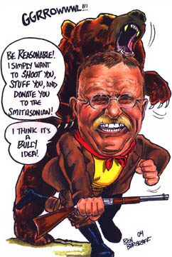
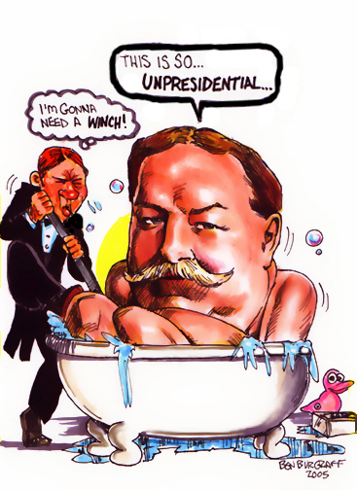
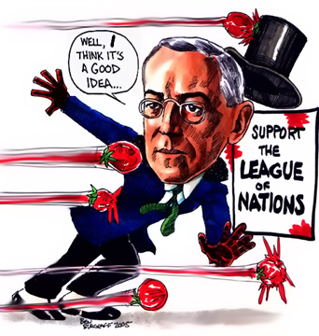
Review of our Presidents from the Progressive Era to Cold War
Teddy Roosevelt ®, William Howard Taft ®, Woodrow Wilson (D)

Slide 2
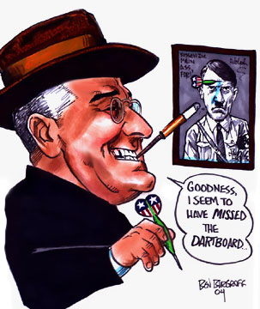
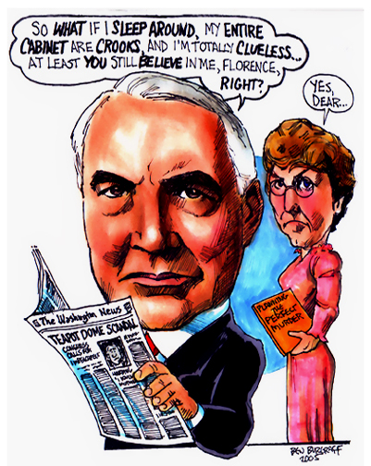
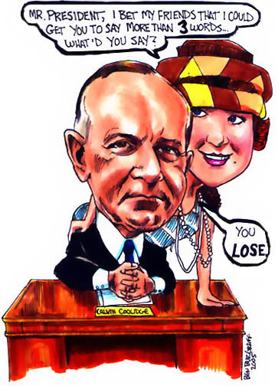
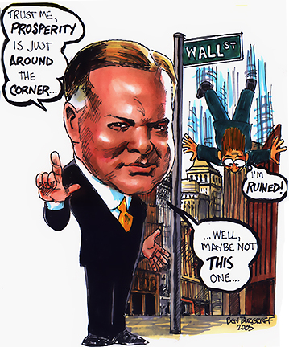
Warren G. Harding ®, Calvin Coolidge (D), Herbert Hoover ®, FDR (D)
Kamikaze – Japanese pilots crashed their bomb-filled planes into Allied ships during the Battle of Leyte Gulf.

Slide 3
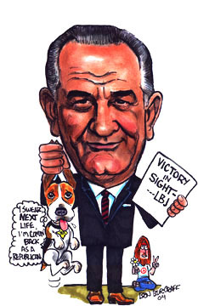
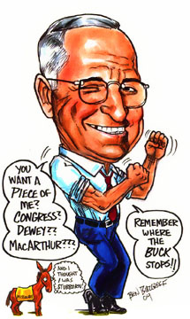
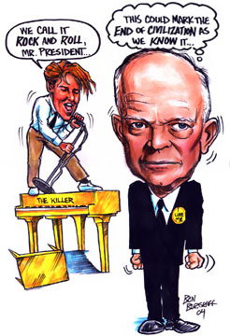
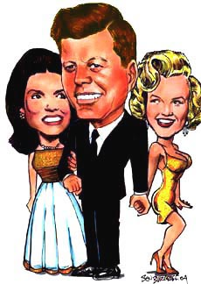
Harry Truman (D), Dwight D. Eisenhower ®, John F. Kennedy (D), Lyndon B. Johnson (D).
into Allied ships during the Battle of Leyte Gulf.

Slide 4
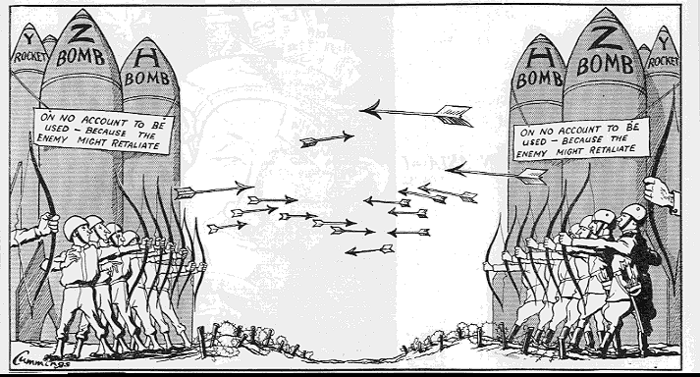
Cold War 1945-1991

Slide 5
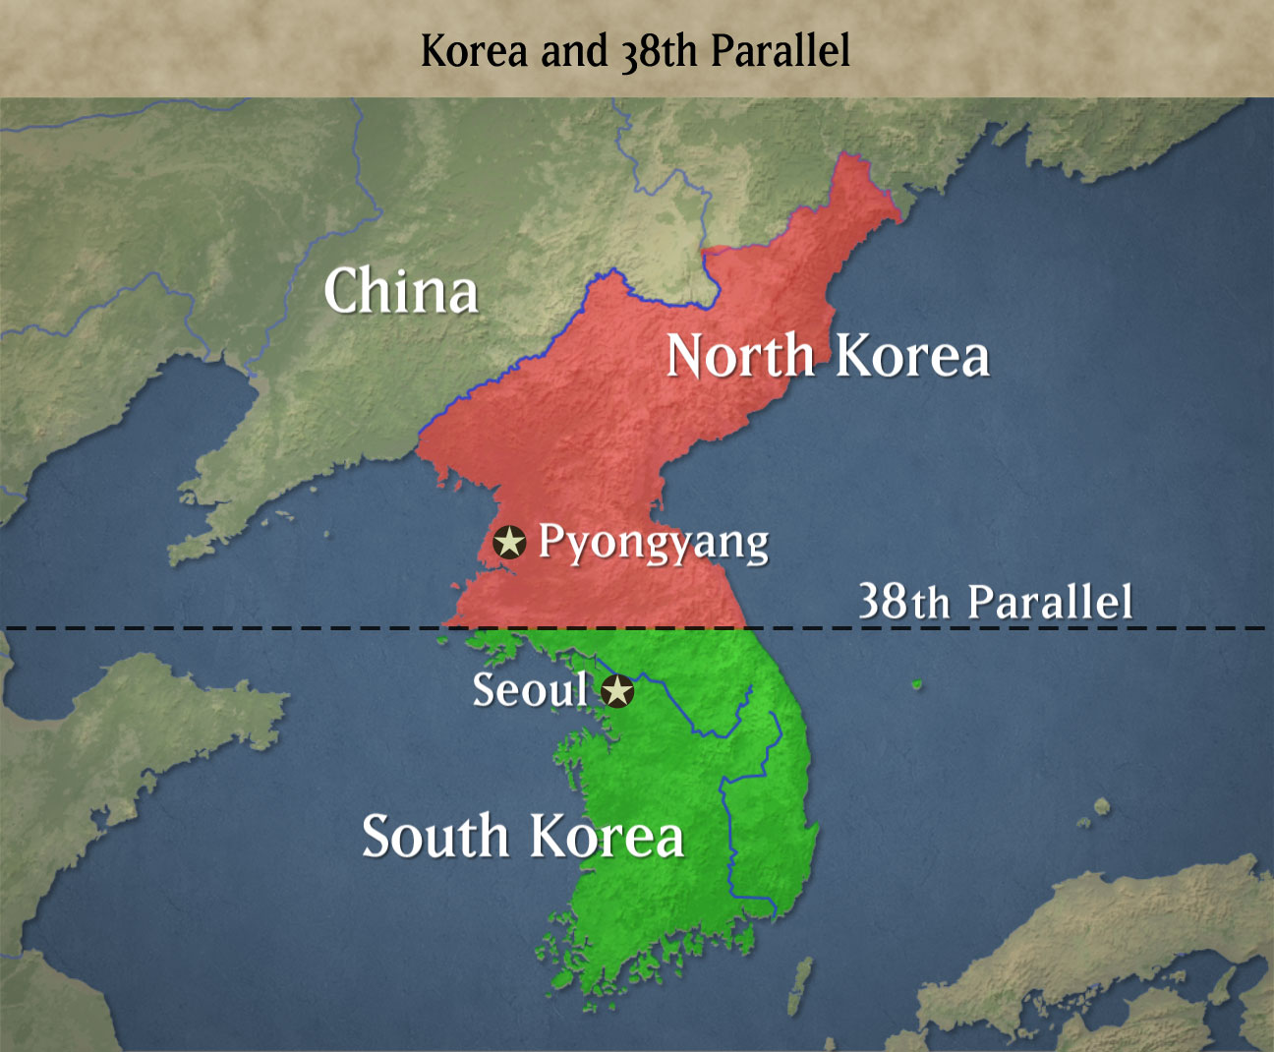
38th parallel-dividing line between North and South Korea. This is where the war started and then ended after 54,000 American lives.

Slide 6
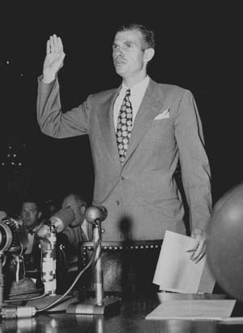
Hiss was accused of being a Soviet spy in 1948 and convicted of perjury in connection Ethel and Julius Rosenberg

Slide 7
Blacklist-A blacklist is a list or register of persons (communists or earlier in our study union reps/strikers) who, for one reason or another, are being denied a particular privilege, service, mobility, access or recognition. To blacklist can mean to deny someone work in a particular field.

Slide 8
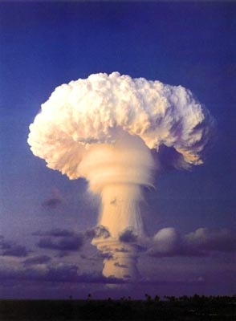
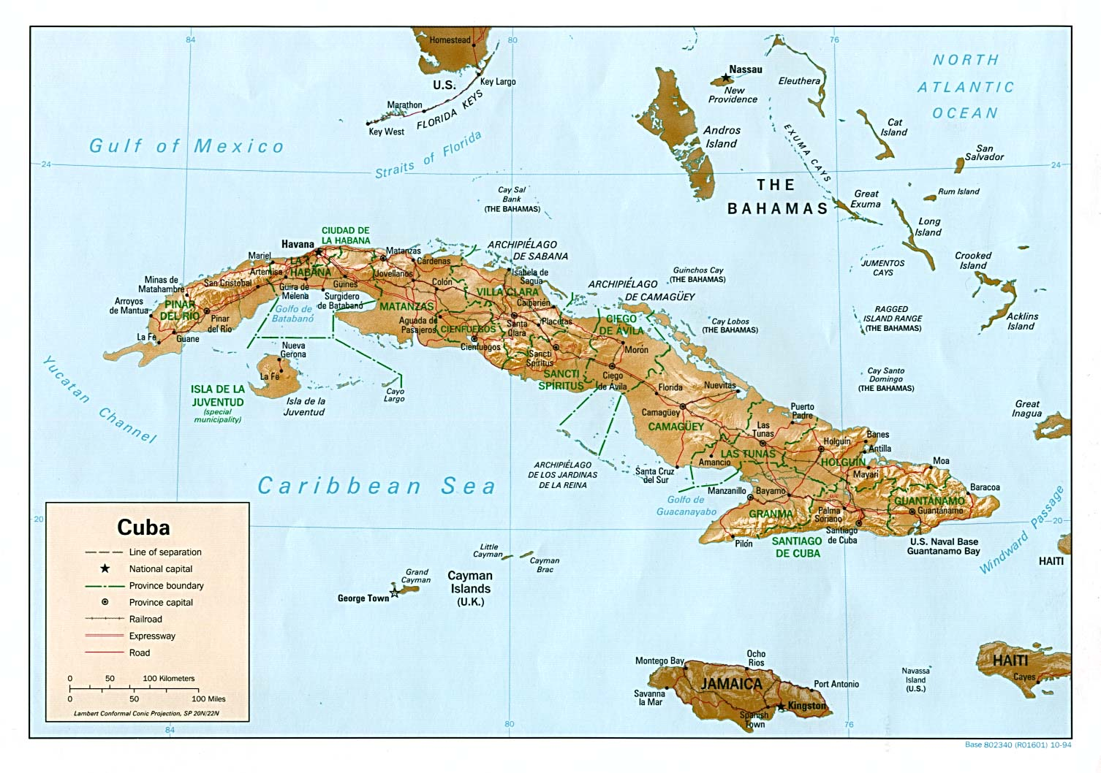
Brinkmanship-is the practice of pushing a dangerous situation to the verge of disaster in order to achieve the most advantageous outcome. It occurs in international politics, foreign policy, labor relations and for our interest in military strategies during the cold war involving the threatened use of nuclear weapons.

Slide 9
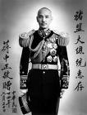
Chian Kai-Shek-Nationalist leader in China before their Communist Revolution, The US supported him and wanted to see his policies prevail. Unfortunately his political rival was able to win over the people and gain more political power.

Slide 10
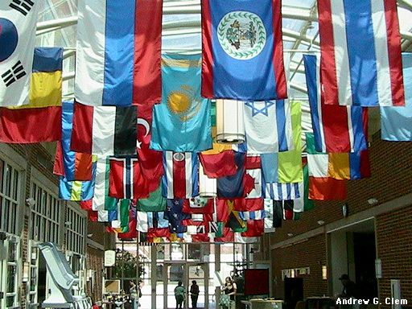
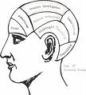
CIA-Central Intelligence Agency-a U.S. agency created to gather secret information about foreign governments. Our intelligence on the USSR was not good.

Slide 11
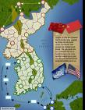
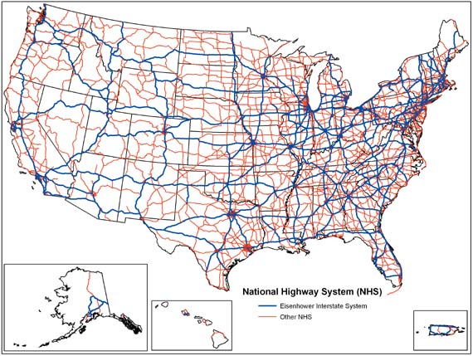
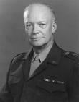
Dwight D. Eisenhower-As President, he oversaw the cease-fire of the Korean War, kept up the pressure on the Soviet Union during the Cold War, made nuclear weapons a higher defense priority, launched the Space Race, enlarged the Social Security program, and began the Interstate Highway System.

Slide 12
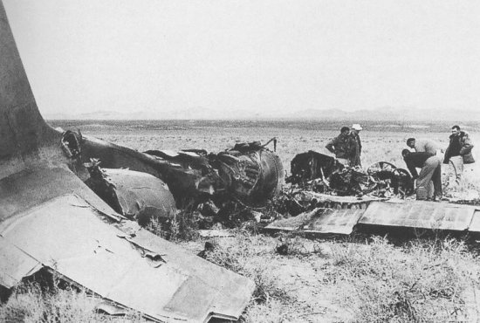
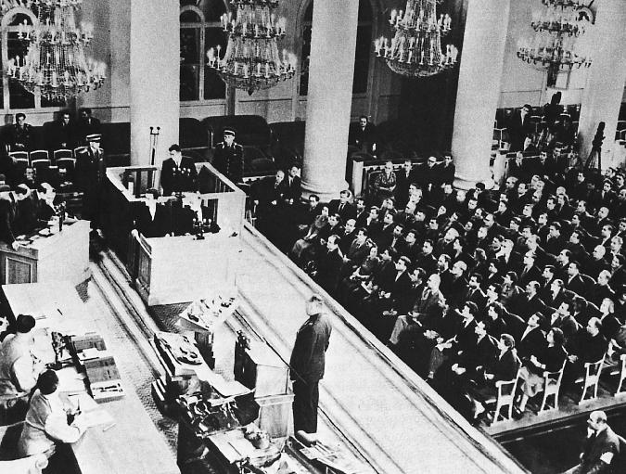
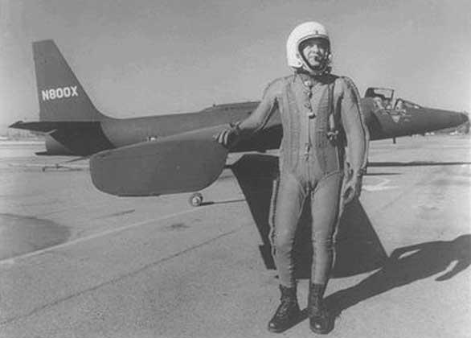
Francis Gary Powers- Pilot who was flying the U-2 spy plane that was shot down over USSR. He was initially sentenced to prison, but was later released.
U-2 Incident-The 1960 U-2 incident occurred during the Cold War on May 1, 1960 (during the presidency of Dwight D. Eisenhower) when an American U-S spy plane was shot down over the Soviet Union. At first, the United States government denied the plane's purpose and mission, but was forced to admit its role as a covert surveillance aircraft when the Soviet government produced its remains (largely intact) and surviving pilot, Gary Powers.

Slide 13
HUAC-House of Un-American Activities is best known for investigating communism in America and specifically within the film industry.

Slide 14
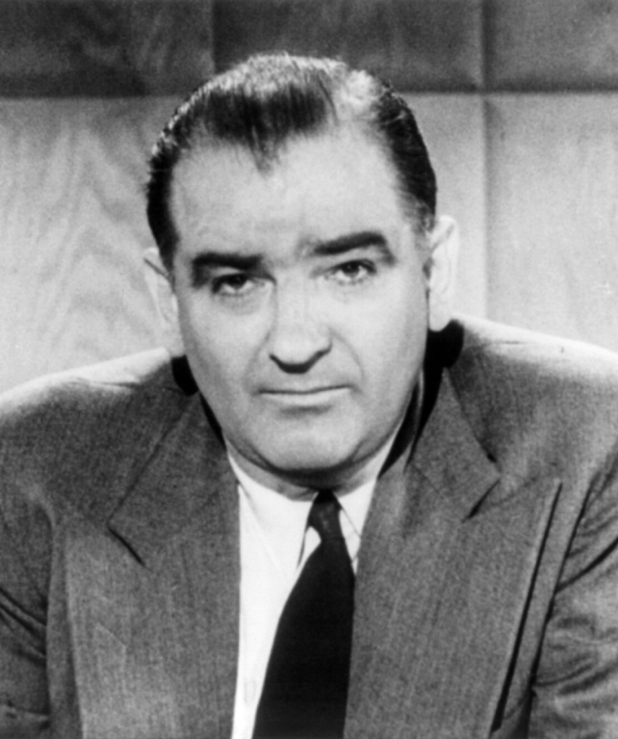
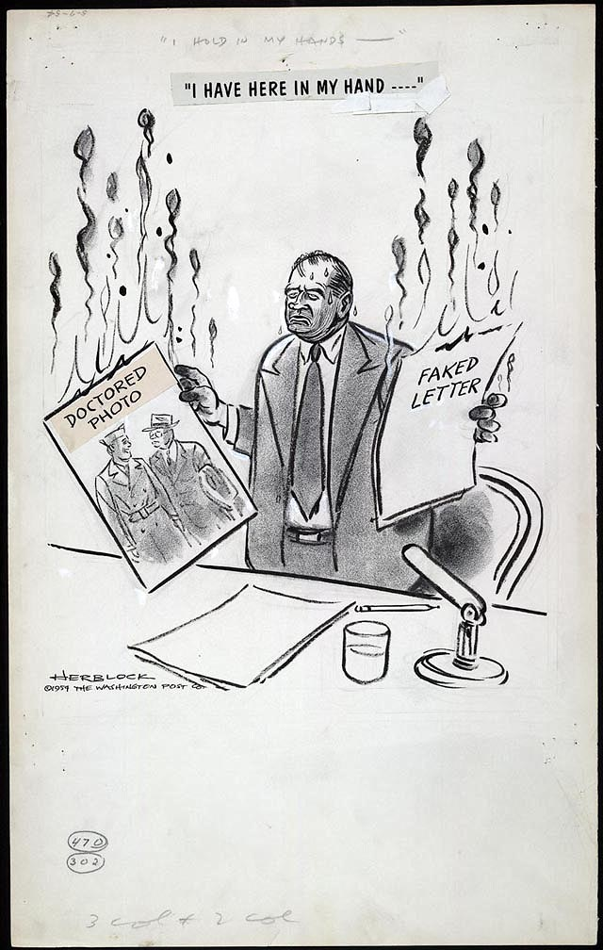
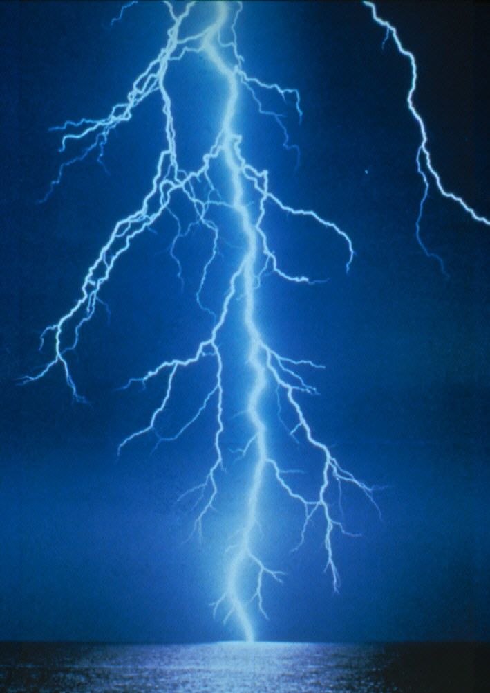
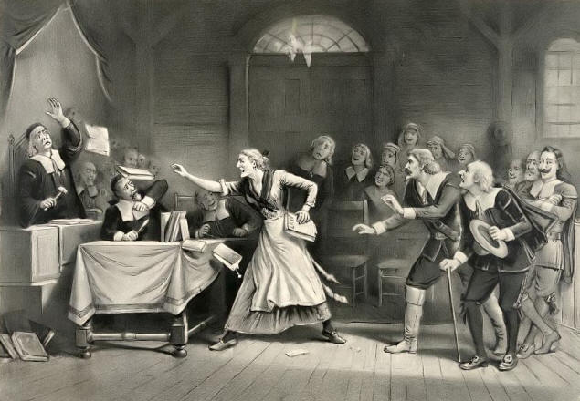
Joseph McCarthy & McCarthyism-A senator from Wisconsin who made unsupported accusations that that person was a communist. Eventually, his wild accusations caught up with him and he was ousted from his govt. position. He also was an alcoholic. (Think of the Salem Witch Trials here)

Slide 15
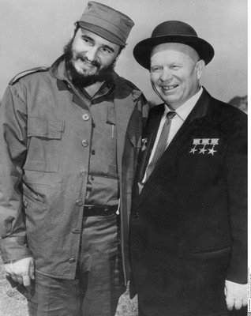
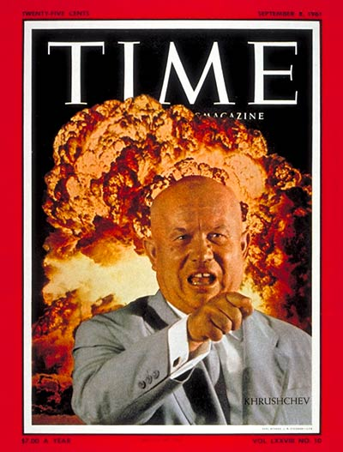
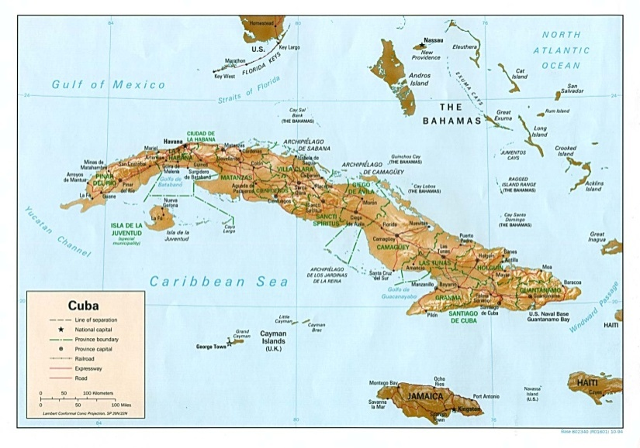
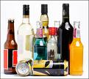
Nikita Khrushchev-Political leader of USSR who succeeded Stalin, like McCarthy was an alcoholic who brought the world very close to WW III/Nuclear War.
.

Slide 16
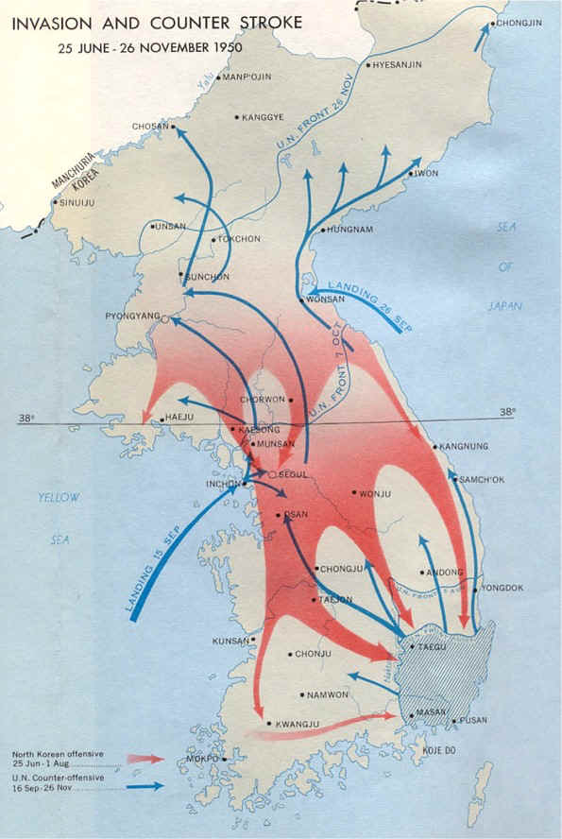
Korean War-The Korean War refers to a period of military conflict between North Korean and South Korean regimes, with major hostilities lasting from June 25, 1950 until the armistice signed on July 27, 1953.

Slide 17
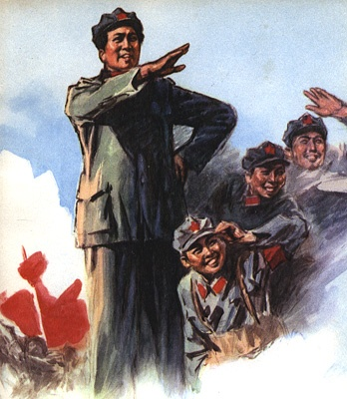
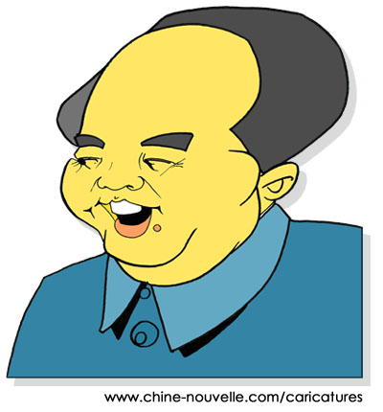
Mao Zedong--Communist leader of China who was once quoted as saying to the U.S. “your nuclear weapons are like a paper tiger”, he along almost brought the US into another nuclear war.

Slide 18
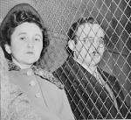
Ethel and Julius Rosenberg-were American communists who were executed after having been found guilty of conspiracy to commit espionage. The charges were in relation to the passing of information about the atomic bomb to the Soviet Union.

Slide 19
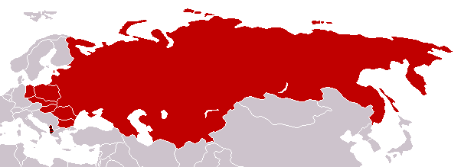
Warsaw Pact – pro Soviet countries – USSR, and all countries controlled by the USSR.
COMMUNISM

Slide 20
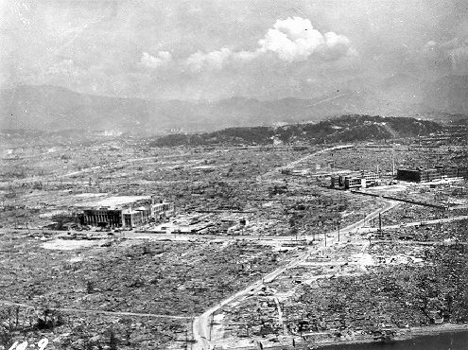
H-Bomb-1952 Weapon of mass destruction that was 25-50 times more powerful than the original bomb that destroyed Hiroshima. After a test of its power by the US, its byproduct traveled around the world and hand devastating environmental effects. It was estimated that the explosion of 100 H-bombs could have made life in this very world unsustainable.

Slide 21
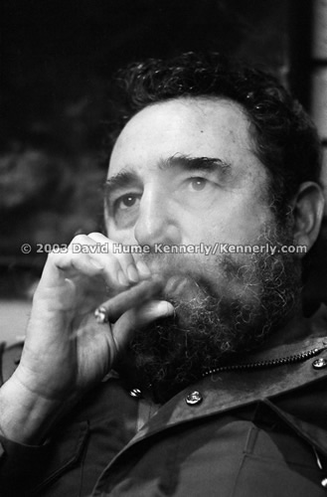
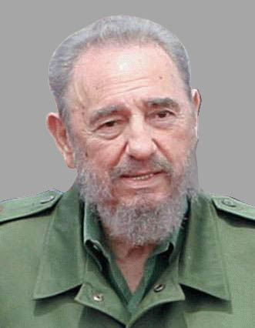
Fidel Castro-revolutionary/communist leader who took over diplomatic power in Cuba.

Slide 22
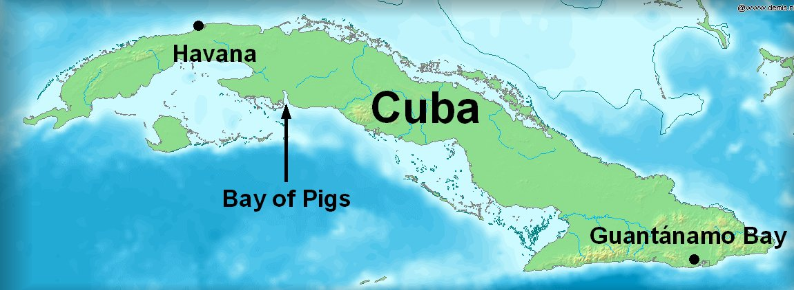
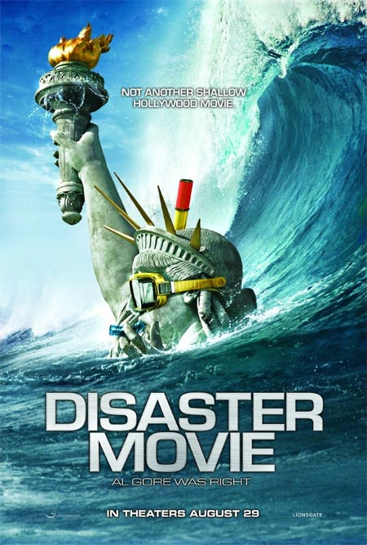
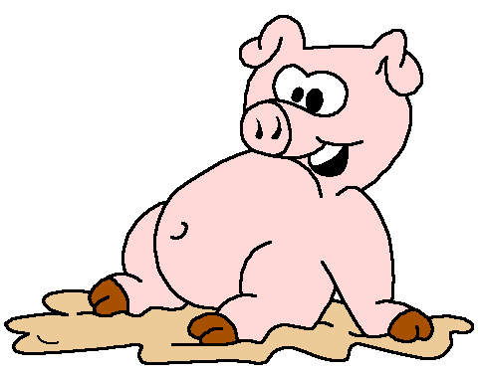
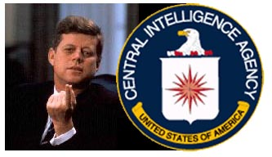
Bay of Pigs Invasion–April 17th, 1961 1500 Cuban exiles whose objective to overthrow the Cuban govt., failed miserably as they faced 25,000 Cuban troops that were back up by Soviet tanks.

Slide 23
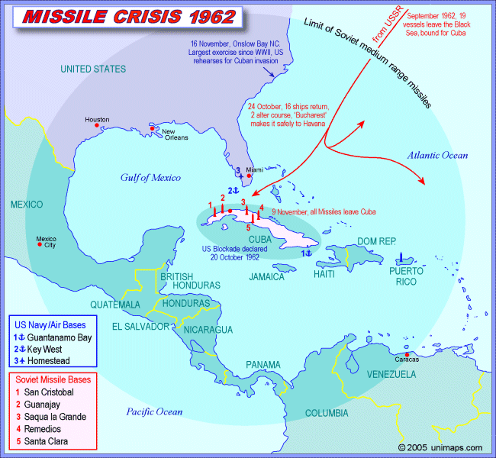
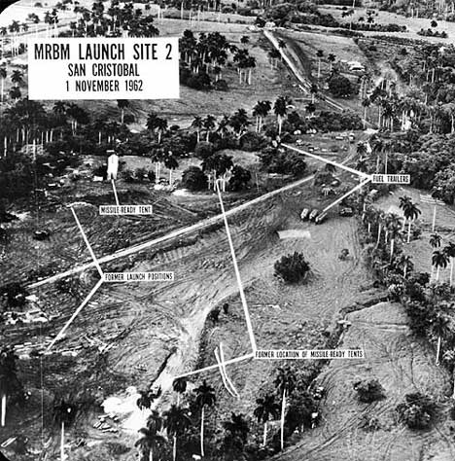
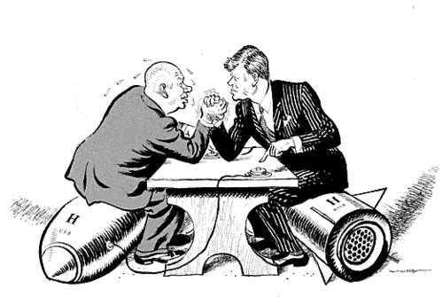
Cuban Missile Crisis-October 14th-October 28^{th,} 1962 where the U.S. and Soviet Union/Cuba came very close to a nuclear war.

Slide 24
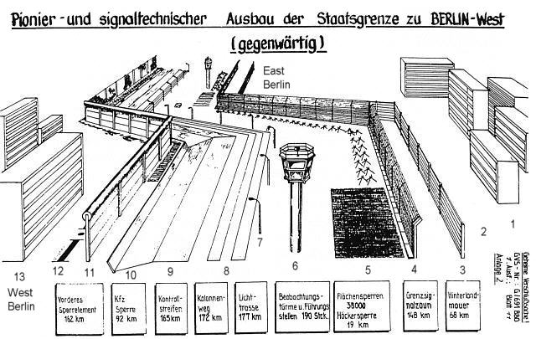
Berlin Wall-a concrete wall topped with barbed wire that severed the city in two (communism/democracy). **Berlin Airlift

Slide 25
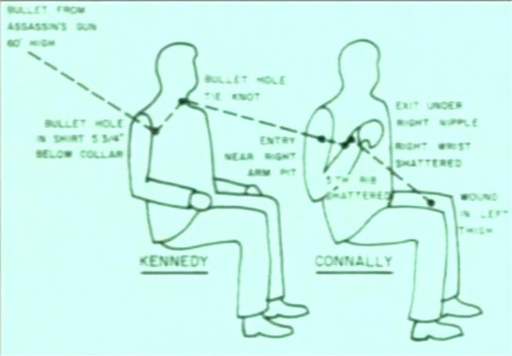
Warren Commission-Commission put together to investigate the death of JFK and ruled that Lee Harvey Oswald acted alone in his assassination of JFK.

Slide 26
4
VS.
Melting Pot- a mixture of people, cultures and races who blended together by abandoning their native languages and customs.
VS.
Salad Bowl- when people of various cultures/immigrants do not lose the unique aspects of their cultures like in the melting pot model, instead they retain them

Slide 27
4
VS.
Racism-certain racial groups/cultures receive preferential treatment, while others are discriminated (Raisin in the Sun, Holocaust, Civil Rights Movement).

Slide 28
4
VS.
Feminism-political, cultural, and economic movement aimed at establishing equal rights and legal protection for women.

Slide 29
4
VS.
American Dream-is a term that is derived from the Declaration of Independence & our founding fathers: "…held certain truths to be self-evident, that all Men are created equal, that they are endowed by their Creator with certain unalienable Rights, that among these are life, Liberty and the Pursuit of Happiness. Often times this pursuit of happiness is having a nice house, 2.5 kids and a white picket fence.

Slide 30
4
The Great Migration- The movement of 1.75 million African Americans out of the Southern U.S. to the North and Midwest and West from the early 1900’s -1930.

Slide 31
4
Assimilation-mixing together of cultures (examples: Alexander the Great, John Smith/Pocahontas)

Slide 32
17
Question
-One tough bobcat

Slide 33
THE END

Slide 34
Kamikaze – Japanese pilots crashed their bomb-filled planes into Allied ships during the Battle of Leyte Gulf.

Slide 35
Selective Service System – Expanded the draft to include 10 million soldiers to meet the armed forces’ needs.

Slide 36
War Production Board – The government ensured that the armed forces and war industries received the resources they needed to win the war. They decided which companies would convert from peacetime to wartime production.

Slide 37
Nuremberg Trials – Hitler's most trusted party officials, government ministers, military leaders, and powerful industrialists brought to trial for crimes against humanity, crimes against the peace and war crimes by U.S. Supreme Court Justice Robert Jackson.

Slide 38
This powerpoint was kindly donated to
www.worldofteaching.com
http://www.worldofteaching.com
Is home to well over a thousand powerpoints submitted by teachers. This a free site. Please visit and I hope it will help in your teaching
Notes:
38

